Slide 1

Department of Computer Science and Engineering
Synopsis presentation
On
JALSA - Event planning website
(Session: JAN-JUN 2023)
PROJECT-I 6th Sem (BTCS603-18)
Presented By :
Prem kumar (2130938)
Shivam kumar raj(2027839)
Md rashid khan(2027797)

Slide 2
Event planning website
Introduction:
An event planning website is an online platform that allows users to plan, organize, and manage events.
It is important because it can streamline the event planning process and make it easier to collaborate with others involved in the event.
Event planning websites can help users with tasks such as setting a budget, creating a schedule, sending invitations and tracking expenses.
With an event planning website, users can save time and reduce stress by having all the necessary information and tools in one place.

Slide 3
Objective and Scope of the project:
Objective:
The objective of this project is to create an event planning website that will simplify the process of organizing and managing events for users. The website will provide a range of features and tools to help users plan and execute events more efficiently and effectively.
Scope:
The scope of this project will include the following:
Development of a user-friendly website with a clean and modern design.
Creation of a dashboard that allows users to manage multiple events and access all relevant information in one place.
Implementation of features such as event creation, guest management, budgeting, and task management.
Integration with third-party services such as social media platforms, email marketing tools, and payment gateways.
Testing and debugging of the website to ensure optimal performance and user experience

Slide 4
Type of Tools and Technology to be Used
Hardware requirement:
Windows7
8GB RAM
Software requirement:
Windows 7
MY SQL
HTML,CSS,JAVASCRIPT
NODE.JS

Slide 5
:
FRONT END TECHNOLOGIES:-
HTML:
HTML (Hypertext Markup Language) is a standard markup language used for creating and structuring content on the web. It is a foundation of the World Wide Web and allows web developers to create static web pages or dynamic web applications.
CSS:
CSS (Cascading Style Sheets) is a style sheet language used to describe the visual presentation of HTML. It allows web developers to separate the content and structure of a web page from its presentation and layout.
Javascript:
JavaScript is a high-level programming language used to create interactive web pages and web applications.
BACKEND TECHNOLOGIES:-
Node.js:
Node.js is an open-source, cross-platform JavaScript runtime environment that allows developers to build server-side applications using JavaScript.

Slide 6
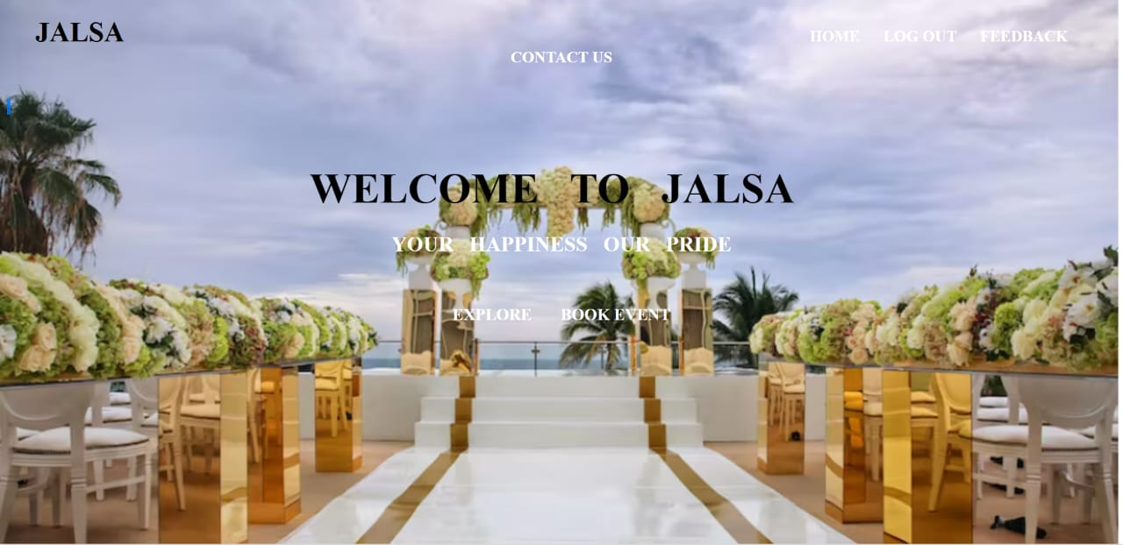
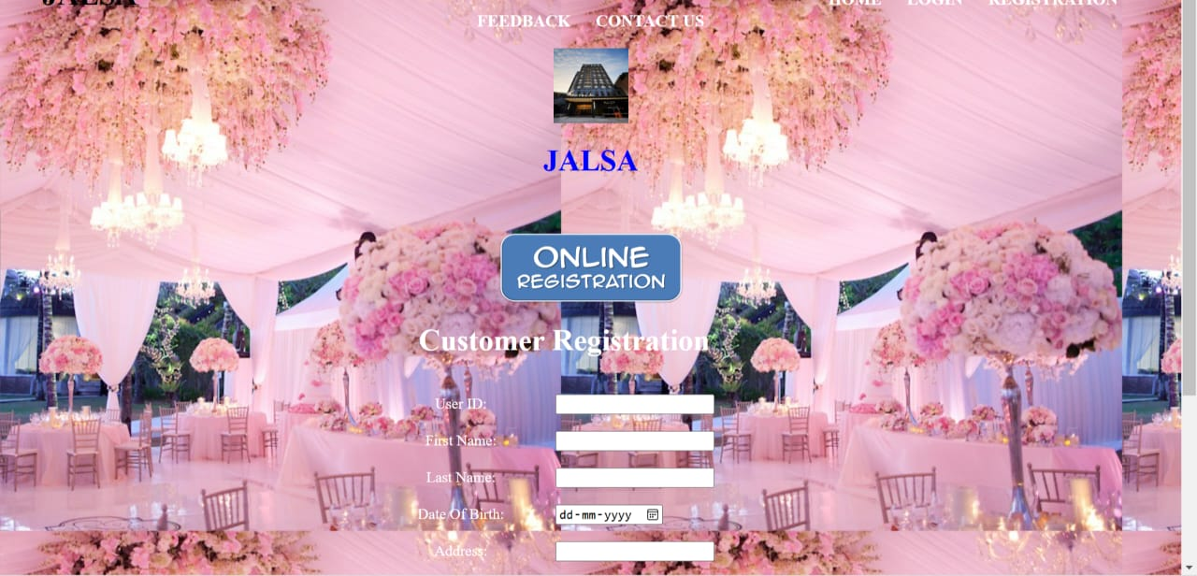
RESULT:-
HOME PAGE
REGISTRATION PAGE

Slide 7
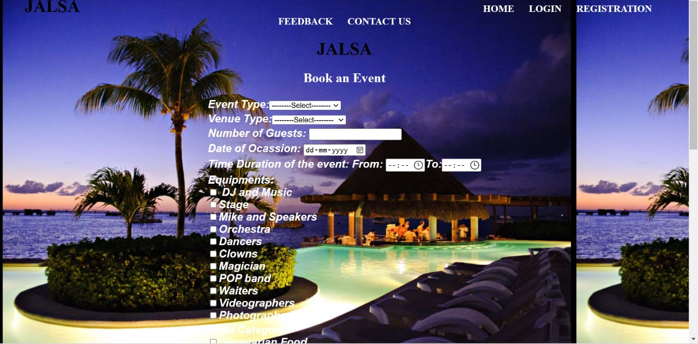
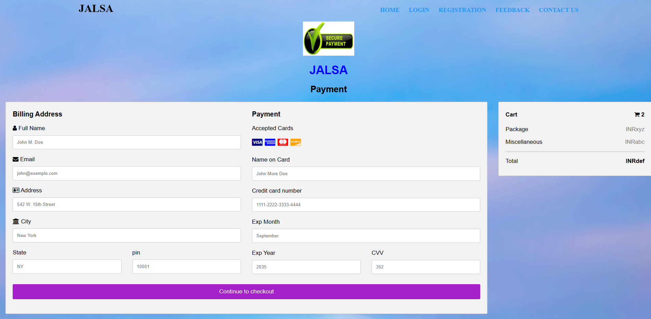
TO BOOK AN EVENT
PAYMENT PAGE

Slide 8
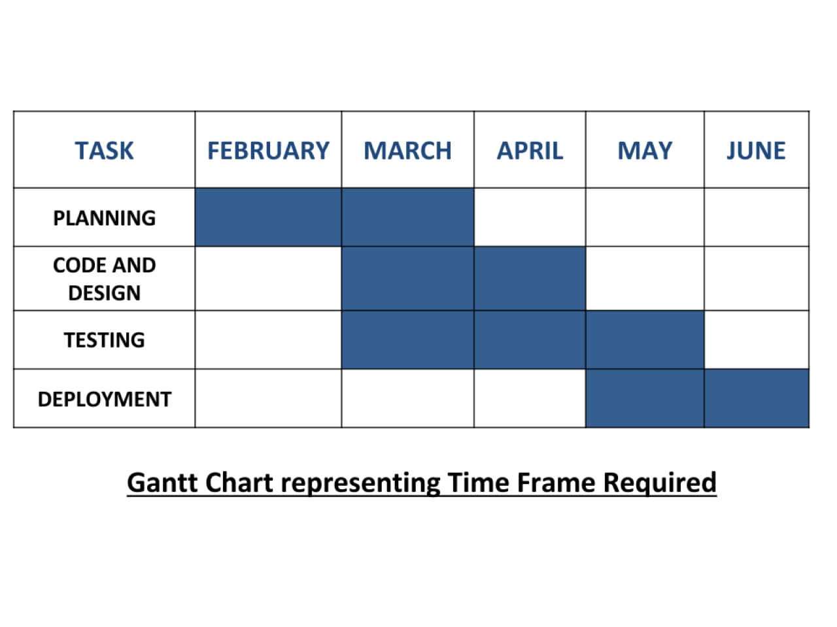
Process Description and Time Frame Required for various stages of Project Implementation

Slide 9
Conclusion & Future Scope
event planning is a crucial aspect of organizing successful events, and an event planning website can make the process more efficient and streamlined. By providing a comprehensive platform for managing everything from registration to marketing and communication with attendees, an event planning website can help event organizers save time and reduce administrative tasks.
Looking to the future, the scope of event planning websites will likely continue to expand, with more advanced features and tools that cater to the specific needs of different types of events and audiences. These could include features such as virtual event planning, augmented reality experiences, and AI-powered event analytics. Overall, the future of event planning looks promising, with technology playing an increasingly important role in making events more successful and engaging for attendees.

Slide 10
References
https://www.javatpoint.com/
https://tutedude.com/tracks/fullstackdevelopment
https://fonts.google.com/
https://www.dukelearntoprogram.com//course1/doc/#css
https://www.w3schools.com/cssref/css_

